Slide 1
How to Deliver an Excellent Oral Research Presentation
January 18, 2017
Mary Ann Leung, Ph.D.
President & Founder
Sustainable Horizons Institute

Slide 2
Webinar is 60 minutes
Q&A box to submit questions
Office hours for additional questions
Administrative details

Slide 3
Poll Question
What is your academic status?
Undergraduate
Masters
Doctoral
Other

Slide 4
Poll Question
Have you ever given an oral presentation at a conference?
No
Yes

Slide 5
Poll Question
Are you planning on presenting at ERN?
No
Yes

Slide 6
Why give an oral?
Preparing your slides
Preparing yourself
Discussion
Presenting
Judging criteria

Slide 7
Oral Presentation of your Research
Share your research results
Communicate your excitement for research
Demonstrate your knowledge, skills, abilities
Learn from others
Learn about opportunities
Prizes!
Why give an oral?
Preparing your slides
Preparing yourself
Discussion
Presenting
Judging criteria

Slide 8
Your orals will typically be judged on:
Abstract
Statement of the Problem
Methodology
Results
Future Work
Oral Presentation and Response to Questions
Overall Presentation
Why give an oral?
Preparing your slides
Preparing yourself
Discussion
Presenting
Judging criteria

Slide 9
Organizing your ideas for your audience
Who is your audience?
What do they know or not know?
Organize your presentation
Overview/Motivation (Why should I care?)
Background
Methods
Results
Discussion
Future Work
Acknowledgements
Why give an oral?
Preparing your slides
Preparing yourself
Discussion
Presenting
Judging criteria

Slide 10
Your presentation should tell a story
Every story has a
Beginning
Actors
Middle
Some twists and turns
Ending
Questions
What you discovered

Slide 11
Telling a scientific story
In science, you learn more and more about less and less
Balancing technical detail with reaching your audience is an art
Your audience may be scientifically adept, but not in your particular area/project
Communicating to someone not knowledgeable in your area can take you a long way!

Slide 12
Tell your story in the right context
Know your audience
Tell a good – organized story
Balance scientific detail with the big picture in an understandable way

Slide 13
Poll Question
Is ERN a technical conference focused on specific sub-discipline?
No
Yes

Slide 14
Poll Question
Does the conference cover broad disciplines?
No
Yes

Slide 15
Professional presentation software and templates
Use professional software and templates
Be creative, but professional
Don’t use excessive “flashy” tricks that distract from your message
Use colors to highlight text sparingly
Include a title for each slide
Keep text and equations to a minimum
Include graphics, charts, images
Run a spell checker!

Slide 16
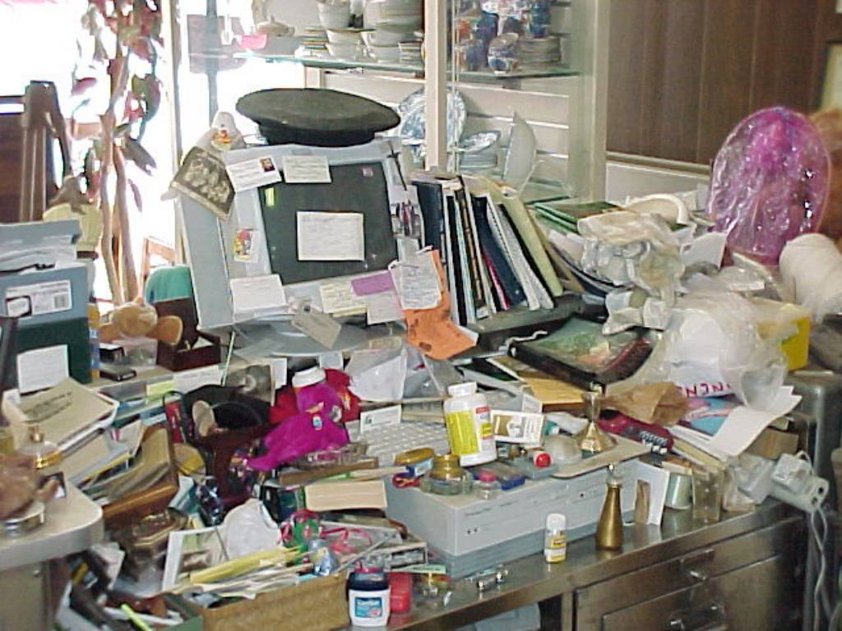
Chunking and organizing your thoughts
Do not put too much information, text, or imagery on one slide
Use the 5-7 rule (no more than 5-7 bullets per slide)
Break up your thoughts into small bite size pieces
Develop a logical flow between slides
Use transitions, as appropriate
Use sign posts, as appropriate

Slide 17
Example sign posts
Sign posts tell people where you are in the overall process
Topic 1
Topic 2
Topic 3
Topic 1
Topic 2
Topic 3
Topic 1
Topic 2
Topic 3
Topic 1
Topic 2
Topic 3

Slide 18
What to include on your slides
Use large letters (no fonts smaller than 16 pts!!)
View your presentation from the back of the room
Do not use different fonts or type styles; (one or two)
Keep the graphics simple
Don't show graphs you won't need
If you only discuss 1 of 4 graphs, cut others out
If you do not have artistic talent ask for help
Use cartoons or illustrations
Combine graphics and text
Appeal to different learning styles

Slide 19
Anatomy of a good talk
Overview/Motivation (Why I care?)
What does this mean?
Background
Methods
Summary
(Tell them what you told them)
Related work (What others did before you)
Results
Discussion
Future Work
Acknowledgements
Overview
Tell them what you are going to tell them
Procedures
(What you did)
What we still need to do to understand
Motivation
Real World Application
(Why you did it)
Results (What you discovered)
Who helped, funded, etc.

Slide 20
Professional presentation software and templates
Practice, practice, practice!
Peers
People who don’t know your research
People similar to your expected audience
By yourself so you can get your language set
Know your stuff
Prepare for questions
Prepare to dance on your feet
Why give an oral?
Preparing your slides
Preparing yourself
Discussion
Presenting
Judging criteria

Slide 21
Look the part
Wear professional attire
No sandals
No tennis shoes
No halter tops
No t-shirts
No tight or revealing clothing
No clothing with printing that is suggestive, offensive, obscene, or promotes illegal substances
No athletic clothing including sweat pants and sweat shirts
No sleepwear, including pajama bottoms
Posture
Stand up straight
Don’t “fidget”
Don’t play with your hair
Why give an Oral?
Preparing your slides
Preparing yourself
Discussion
Presenting
Judging criteria

Slide 22
Speak the part
Speak
Loud
Clearly
Confidently
Do not
Mumble
Chew gum
Avoid making distracting noises or motions

Slide 23
Connect with your audience
Make eye contact
Smile
Ask questions; engage audience
Answer questions
Be courteous
Talk to your audience, not the screen
Convey your excitement!
Make eye-contact
with audience

Slide 24
Summary Checklist
Set the stage; prepare yourself and space ahead of time
Get ready to perform; know your lines and your subject
Overcome your fear of public speaking
Breathe slowly and deeply before your talk
Visualize yourself giving a relaxed talk to a receptive audience
Do affirmations. Tell yourself you are relaxed, confident — whatever works for you
Assume one or more “power poses,” Dr. Amy Cuddy of the Harvard Business School

Slide 25
Summary Checklist
Stride up to the podium
Stand tall and keep your chest lifted
Smile; you appear more relaxed; reduces stress
Speak up
Take your time, but stay on time
Talk to the audience, not the screen
Don’t drift off at the end
Say “That concludes my presentation. Thank you for your attention.”
Ask for questions

Slide 26
Be yourself…your professional self!
Be personable; helps to establish rapport
Be yourself…your professional self

Slide 27
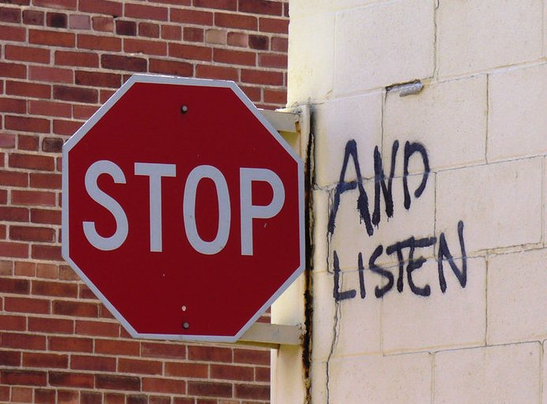
Taking questions
Listen to the question first
Repeat question, if necessary
Reply with confidence
Take your time to explain, remember others don’t know as much as you do about your research
Its okay to not know the answer, admit it and research it
Why give an Oral?
Preparing your slides
Preparing yourself
Discussion
Presenting
Judging Criteria

Slide 28
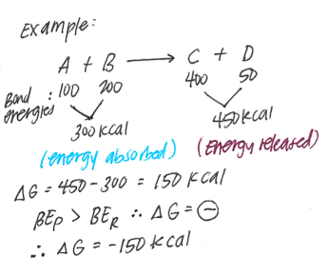
A few examples
Include multiple methods
Imagery
Motion/video
Analogies
So much content is at your fingertips
Following are slides from a leadership talk to scientists

Slide 29
Natural self assembly

Slide 30
Self assembly of carbon nanotube
http://www.youtube.com/watch?v=1kWApU3o6ko

Slide 31
Coordinated Self Assembly in Organizational Leadership
http://robohub.org/the-distributed-flight-array-modular-robots-that-self-assemble-coordinate-and-take-flight/

Slide 32
Questions?
Comments
Feedback/suggestions

Slide 33
Office Hours:
Wednesday, Jan 18 2-3pm
Tuesday, Jan 21, 2-3pm
Thursday, Feb 2, 2-3pm
Monday, Feb 13, 11 am -12 pm
Wednesday, Feb 15, 11 am – 12pm
Virtual location:
mleung@shinstitute.org
515-450-8190
Skype: mleung1129
All times are central zone
Good Luck!
Mary Ann Leung, Ph.D.
mleung@shinstitute.org
http://shinstitute.org/

